Slide 1
Net Present Value
Net Present Value
Other Investment Criteria
Project Interactions
Capital Rationing
Notes:
2

Slide 2
Net Present Value
Net Present Value - Present value of cash flows minus initial investments.
Opportunity Cost of Capital - Expected rate of return given up by investing in a project.
Notes:
4

Slide 3
Net Present Value
Example
Q: Suppose we can invest $50 today & receive $60 later today. What is our increase in value?
A: Profit = - $50 + $60
= $10
$10
Added Value
$50
Initial Investment
Notes:
6

Slide 4
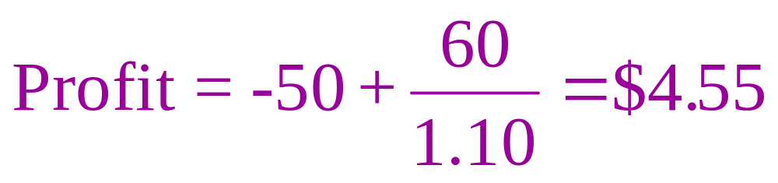
Net Present Value
Example
Suppose we can invest $50 today and receive $60 in one year. What is our increase in value given a 10% expected return?
This is the definition of NPV
$4.55
Added Value
$50
Initial Investment
Notes:
8

Slide 5
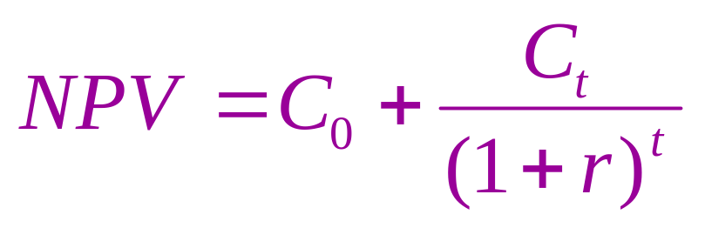
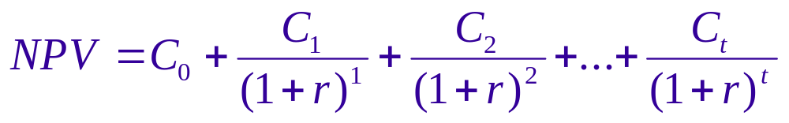
Net Present Value
NPV = PV - required investment
Notes:
11

Slide 6
Net Present Value
Terminology
C = Cash Flow
t = time period of the investment
r = “opportunity cost of capital”
The Cash Flow could be positive or negative at any time period.
Notes:
12

Slide 7
Net Present Value
Net Present Value Rule
Managers increase shareholders’ wealth by accepting all projects that are worth more than they cost.
Therefore, they should accept all projects with a positive net present value.
Notes:
13

Slide 8
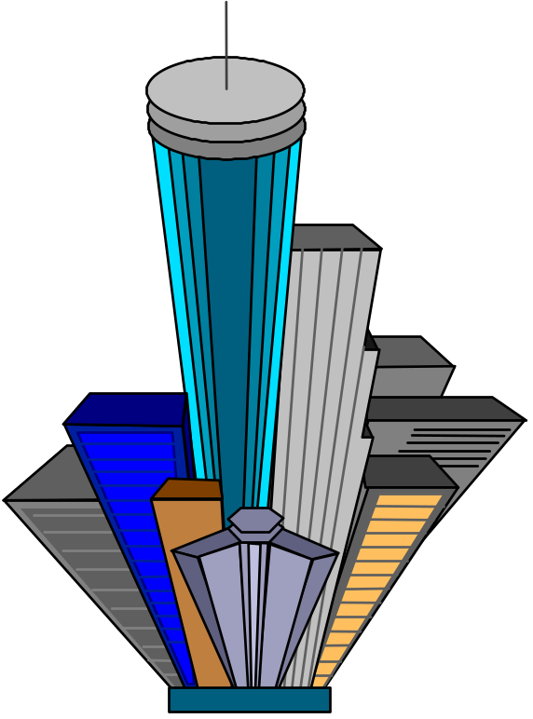
Net Present Value
Example
You have the opportunity to purchase an office building. You have a tenant lined up that will generate $16,000 per year in cash flows for three years. At the end of three years you anticipate selling the building for $450,000. How much would you be willing to pay for the building?
Notes:
14

Slide 9

Net Present Value
$466,000
Example - continued
$450,000
$16,000
$16,000
$16,000
0 1 2 3
You have a cost of capital of 7 %.
Notes:
15

Slide 10
Net Present Value
$466,000
Example - continued
$450,000
$16,000
$16,000
$16,000
Present Value
14,953
13,975
380,395
$409,323
0 1 2 3
Notes:
16

Slide 11
Net Present Value
Example - continued
If the building is being offered for sale at a price of $350,000, would you buy the building and what is the added value generated by your purchase and management of the building?
Notes:
17

Slide 12
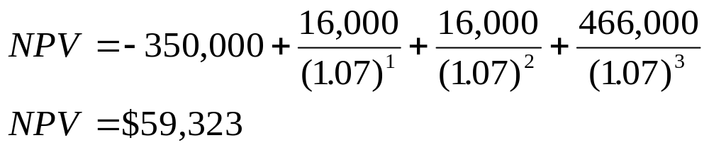
Net Present Value
Example - continued
If the building is being offered for sale at a price of $350,000, would you buy the building and what is the added value generated by your purchase and management of the building?
Notes:
18

Slide 13
Other Investment Criteria
Internal Rate of Return (IRR) - Discount rate at which NPV = 0.
Notes:
19

Slide 14
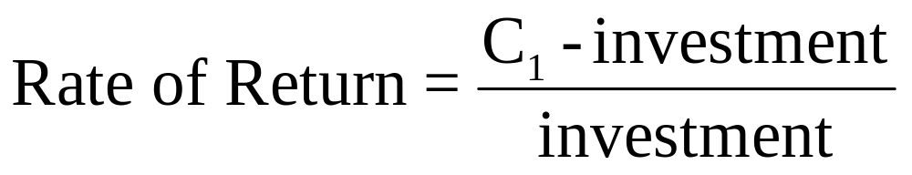
Other Investment Criteria
Internal Rate of Return (IRR) - Discount rate at which NPV = 0.
Rate of Return Rule - Invest in any project offering a rate of return that is higher than the opportunity cost of capital.
Notes:
20

Slide 15
Internal Rate of Return
Example
You can purchase a building for $350,000. The investment will generate $16,000 in cash flows (i.e. rent) during the first three years. At the end of three years you will sell the building for $450,000. What is the IRR on this investment?
Notes:
21

Slide 16
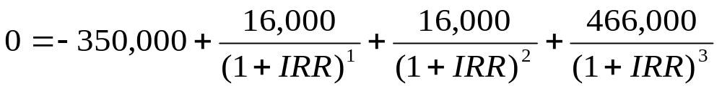
Internal Rate of Return
Example
You can purchase a building for $350,000. The investment will generate $16,000 in cash flows (i.e. rent) during the first three years. At the end of three years you will sell the building for $450,000. What is the IRR on this investment?
Notes:
22

Slide 17
Internal Rate of Return
Example
You can purchase a building for $350,000. The investment will generate $16,000 in cash flows (i.e. rent) during the first three years. At the end of three years you will sell the building for $450,000. What is the IRR on this investment?
IRR = 12.96%
Notes:
23

Slide 18
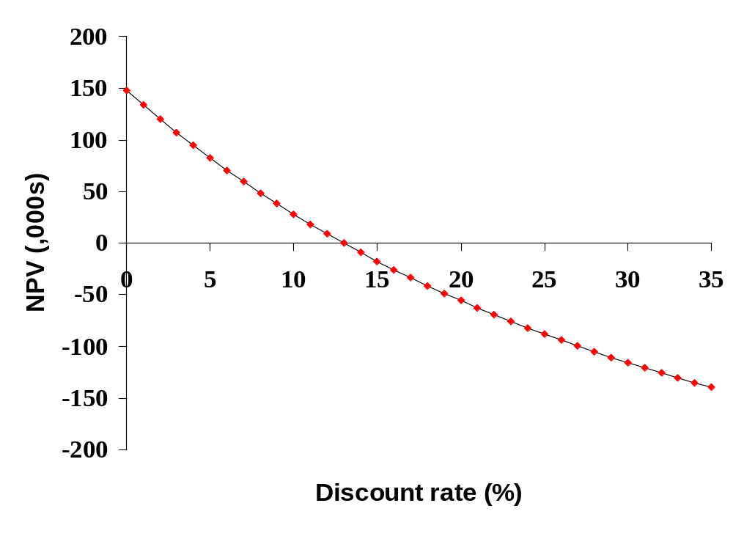
Internal Rate of Return
IRR=12.96%
Notes:
24

Slide 19
Rate of Return Rule
The rate of return is the discount rate at which NPV equals zero.
If the opportunity cost of capital is less than the project rate of return, then the NPV of the project is positive.
The NPV rule and the rate of return rule are positive.

Slide 20
Payback Method
Payback Period - Time until cash flows recover the initial investment of the project.
Notes:
27

Slide 21
Payback Method
Payback Period - Time until cash flows recover the initial investment of the project.
The payback rule specifies that a project be accepted if its payback period is less than the specified cutoff period. The following example will demonstrate the absurdity of this statement.
Notes:
28

Slide 22
Payback Method
Example
The three project below are available. The company accepts all projects with a 2 year or less payback period. Show how this decision will impact our decision.
Notes:
29

Slide 23
Payback Method
Example
The three project below are available. The company accepts all projects with a 2 year or less payback period. Show how this decision will impact our decision.
Cash Flows
Prj. C₀ C₁ C₂ C₃ Payback NPV@10%
A -2000 +1000 +1000 +10000
B -2000 +1000 +1000 0
C -2000 0 +2000 0
Notes:
30

Slide 24
Payback Method
Example
The three project below are available. The company accepts all projects with a 2 year or less payback period. Show how this decision will impact our decision.
Cash Flows
Prj. C₀ C₁ C₂ C₃ Payback NPV@10%
A -2000 +1000 +1000 +10000 2
B -2000 +1000 +1000 0 2
C -2000 0 +2000 0 2
Notes:
31

Slide 25
Payback Method
Example
The three project below are available. The company accepts all projects with a 2 year or less payback period. Show how this decision will impact our decision.
Cash Flows
Prj. C₀ C₁ C₂ C₃ Payback NPV@10%
A -2000 +1000 +1000 +10000 2 +7,249
B -2000 +1000 +1000 0 2 - 264
C -2000 0 +2000 0 2 - 347
Notes:
32

Slide 26
Book Rate of Return
Book Rate of Return - Average income divided by average book value over project life. Also called accounting rate of return.
Notes:
33

Slide 27
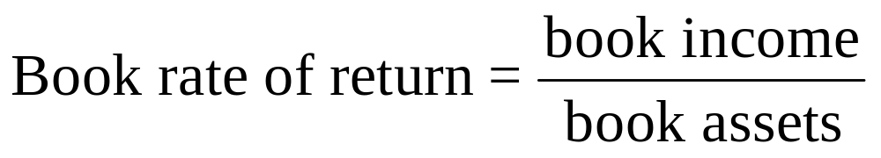
Book Rate of Return
Book Rate of Return - Average income divided by average book value over project life. Also called accounting rate of return.
Managers rarely use this measurement to make decisions. The components reflect tax and accounting figures, not market values or cash flows.
Notes:
34

Slide 28
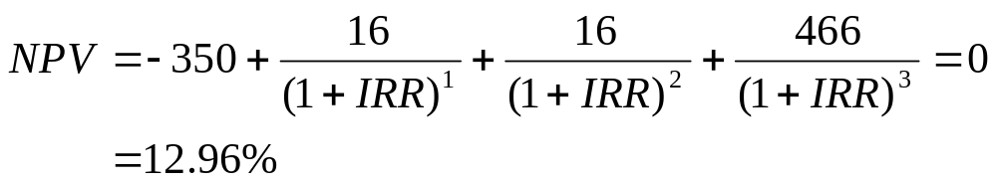
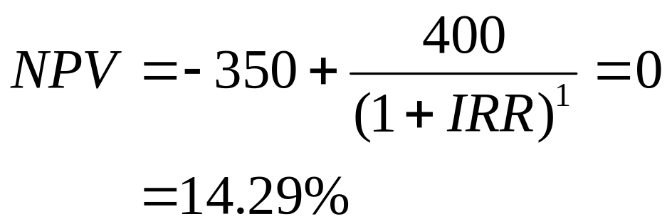
Internal Rate of Return
Example
You have two proposals to choice between. The initial proposal (H) has a cash flow that is different than the revised proposal (I). Using IRR, which do you prefer?

Slide 29
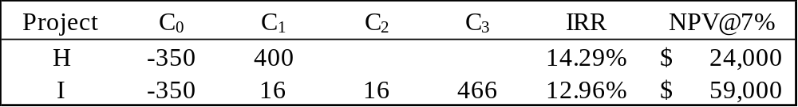
Internal Rate of Return
Example
You have two proposals to choice between. The initial proposal (H) has a cash flow that is different than the revised proposal (I). Using IRR, which do you prefer?

Slide 30
Internal Rate of Return
50
40
30
20
10
0
-10
-20
Revised proposal
NPV $, 1,000s
IRR= 12.96%
IRR= 14.29%
Initial proposal
IRR= 12.26%
8 10 12 14 16
Discount rate, %

Slide 31
Internal Rate of Return
Pitfall 1 - Mutually Exclusive Projects
IRR sometimes ignores the magnitude of the project.
The following two projects illustrate that problem.
Pitfall 2 - Lending or Borrowing?
With some cash flows (as noted below) the NPV of the project increases s the discount rate increases.
This is contrary to the normal relationship between NPV and discount rates.
Pitfall 3 - Multiple Rates of Return
Certain cash flows can generate NPV=0 at two different discount rates.
The following cash flow generates NPV=0 at both (-50%) and 15.2%.

Slide 32
Project Interactions
When you need to choose between mutually exclusive projects, the decision rule is simple. Calculate the NPV of each project, and, from those options that have a positive NPV, choose the one whose NPV is highest.
Notes:
35

Slide 33
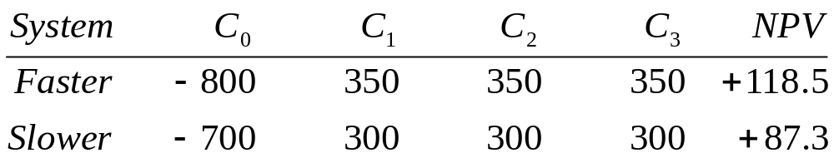
Mutually Exclusive Projects
Example
Select one of the two following projects, based on highest NPV.
assume 7% discount rate
Notes:
36

Slide 34
Investment Timing
Sometimes you have the ability to defer an investment and select a time that is more ideal at which to make the investment decision. A common example involves a tree farm. You may defer the harvesting of trees. By doing so, you defer the receipt of the cash flow, yet increase the cash flow.
Notes:
38

Slide 35
Investment Timing
Example
You may purchase a computer anytime within the next five years. While the computer will save your company money, the cost of computers continues to decline. If your cost of capital is 10% and given the data listed below, when should you purchase the computer?
Notes:
39

Slide 36
Investment Timing
Example
You may purchase a computer anytime within the next five years. While the computer will save your company money, the cost of computers continues to decline. If your cost of capital is 10% and given the data listed below, when should you purchase the computer?
Year Cost PV Savings NPV at Purchase NPV Today
0 50 70 20 20.0
1 45 70 25 22.7
2 40 70 30 24.8
3 36 70 34 Date to purchase 25.5
4 33 70 37 25.3
5 31 70 39 24.2
Notes:
40

Slide 37
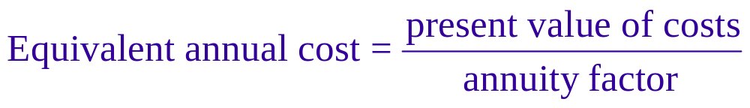
Equivalent Annual Cost
Equivalent Annual Cost - The cost per period with the same present value as the cost of buying and operating a machine.
Notes:
42

Slide 38
Equivalent Annual Cost
Example
Given the following costs of operating two machines and a 6% cost of capital, select the lower cost machine using equivalent annual cost method.
Year
Mach. 1 2 3 4 PV@6% Ann. Cost
D -15 -4 -4 -4
E -10 -6 -6
-25.69
-21.00
- 9.61
-11.45
Notes:
45

Slide 39
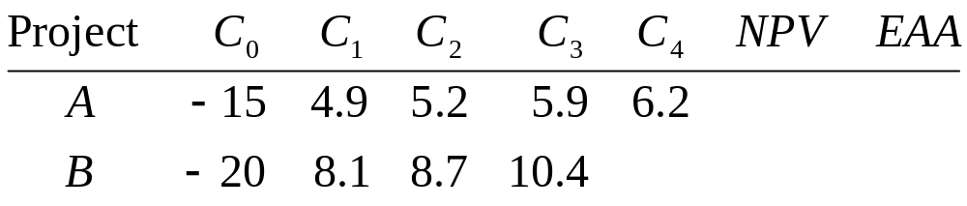
Equivalent Annual Cost
Example (with a twist)
Select one of the two following projects, based on highest “equivalent annual annuity” (r=9%).
2.82
2.78
.87
1.10
Notes:
47

Slide 40
Capital Rationing
Capital Rationing - Limit set on the amount of funds available for investment.
Soft Rationing - Limits on available funds imposed by management.
Hard Rationing - Limits on available funds imposed by the unavailability of funds in the capital market.
Notes:
48

Slide 41
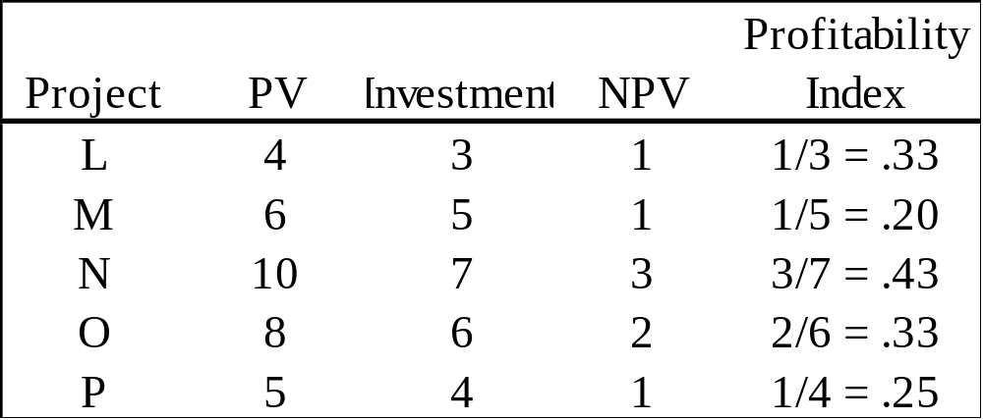
Profitability Index

Slide 42
Project Interactions
When you need to choose between mutually exclusive projects, the decision rule is simple. Calculate the NPV of each project, and, from those options that have a positive NPV, choose the one whose NPV is highest.
Notes:
35

Slide 43
Mutually Exclusive Projects
Example
Select one of the two following projects, based on highest NPV.
Proj 0 1 2 3 4 NPV
A -15 5.5 5.5 5.5 5.5
B -20 9 9 9
assume 9% discount rate
Notes:
36

Slide 44
Mutually Exclusive Projects
Example
Select one of the two following projects, based on highest NPV.
Proj 0 1 2 3 4 NPV
A -15 5.5 5.5 5.5 5.5 2.82
B -20 9 9 9 2.78
assume 9% discount rate
Notes:
37

Slide 45
Investment Timing
Sometimes you have the ability to defer an investment and select a time that is more ideal at which to make the investment decision. A common example involves a tree farm. You may defer the harvesting of trees. By doing so, you defer the receipt of the cash flow, yet increase the cash flow.
Notes:
38

Slide 46
Investment Timing
Example
You may purchase a computer anytime within the next five years. While the computer will save your company money, the cost of computers continues to decline. If your cost of capital is 10% and given the data listed below, when should you purchase the computer?
Notes:
39

Slide 47
Investment Timing
Example
You may purchase a computer anytime within the next five years. While the computer will save your company money, the cost of computers continues to decline. If your cost of capital is 10% and given the data listed below, when should you purchase the computer?
Year Cost PV Savings NPV at Purchase NPV Today
0 50 70 20 20.0
1 45 70 25 22.7
2 40 70 30 24.8
3 36 70 34 Date to purchase 25.5
4 33 70 37 25.3
5 31 70 39 24.2
Notes:
40

Slide 48
Equivalent Annual Cost
Equivalent Annual Cost - The cost per period with the same present value as the cost of buying and operating a machine.
Notes:
41

Slide 49
Equivalent Annual Cost
Equivalent Annual Cost - The cost per period with the same present value as the cost of buying and operating a machine.
Notes:
42

Slide 50
Equivalent Annual Cost
Example
Given the following costs of operating two machines and a 6% cost of capital, select the lower cost machine using equivalent annual cost method.
Notes:
43

Slide 51
Equivalent Annual Cost
Example
Given the following costs of operating two machines and a 6% cost of capital, select the lower cost machine using equivalent annual cost method.
Year
Mach. 1 2 3 4 PV@6% Ann. Cost
D -15 -4 -4 -4
E -10 -6 -6
Notes:
44

Slide 52
Equivalent Annual Cost
Example
Given the following costs of operating two machines and a 6% cost of capital, select the lower cost machine using equivalent annual cost method.
Year
Mach. 1 2 3 4 PV@6% Ann. Cost
D -15 -4 -4 -4 -25.69 -9.61
E -10 -6 -6 -21.00 -11.45
Notes:
45

Slide 53
Equivalent Annual Cost
Example (with a twist)
Select one of the two following projects, based on highest “equivalent annual annuity” (r=9%).
Proj 0 1 2 3 4 NPV Eq. Ann
A -15 5.5 5.5 5.5 5.5
B -20 9 9 9
Notes:
46

Slide 54
Equivalent Annual Cost
Example (with a twist)
Select one of the two following projects, based on highest “equivalent annual annuity” (r=9%).
Proj 0 1 2 3 4 NPV Eq. Ann
A -15 5.5 5.5 5.5 5.5 2.82 .87
B -20 9 9 9 2.78 1.10
Notes:
47

